Slide 1
Real Estate Final Presentation
By
Prajakta Are

Slide 2
Executive Dashboard
Business Problem
Management did not have a single-page summary of overall property performance.
Difficult to track total sales, portfolio value, sold properties, and market trends together.
Decision-making was slow due to scattered KPIs across reports.
Solution
Created an Executive Overview Dashboard with key KPIs:
  Total Properties
  Sold Properties
  Total Sales Value
  Portfolio Value
  Average Listed Price
Added market value trend over time and city-wise market value comparison.
Enabled leadership to quickly understand business health and take faster decisions.

Slide 3
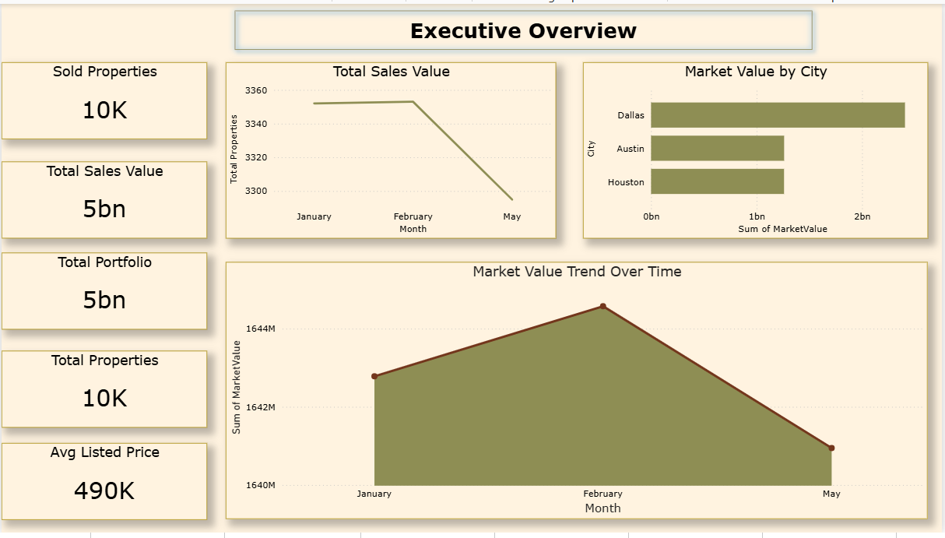

Slide 4
Pricing & Market Value Analysis Dashboard
Business Problem
No clarity on pricing gaps between listed price and market value.
Hard to identify which property types contribute most to portfolio value.
Pricing strategy was based on assumptions, not data.
Solutions
Built Pricing & Market Value Analysis Dashboard with:
Average Listed Price vs Average Market Value
Price Gap KPI
Portfolio Value Distribution by Property Type
Added top property types by market value to guide pricing decisions.
Helped business optimize pricing and maximize revenue.

Slide 5
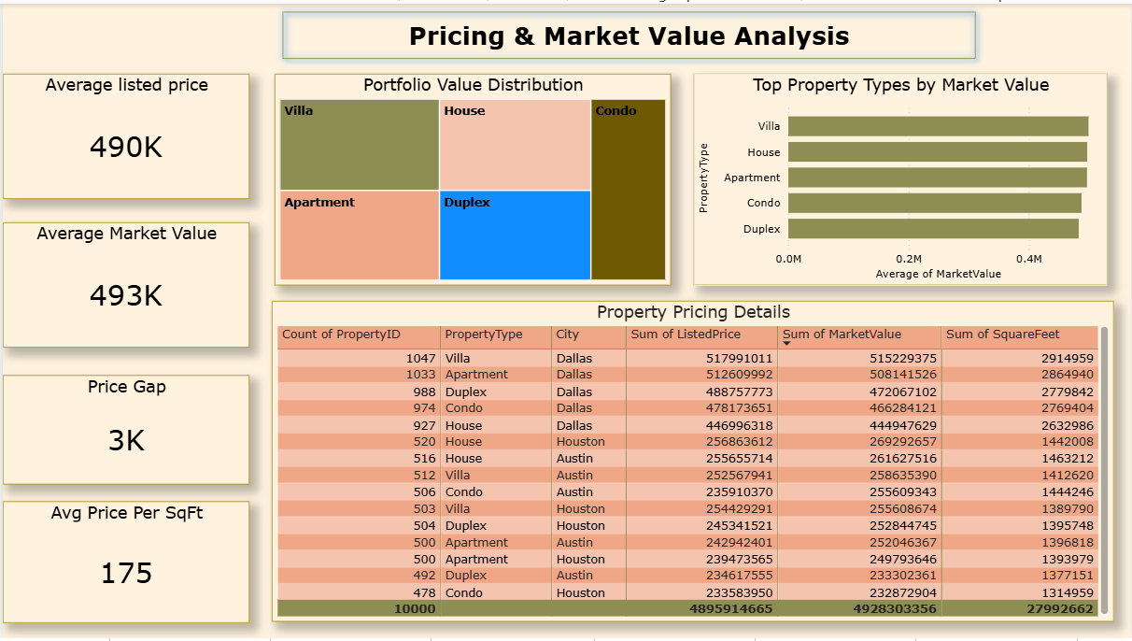

Slide 6
Agent & Office Performance Dashboard
Business Problem
Management could not measure agent productivity and office contribution.
No visibility into drivers of portfolio value.
Difficult to reward top-performing agents and offices.
Solution
Designed Agent & Office Performance Dashboard:
  Total Agents, Total Offices, Properties per Agent
  Decomposition Tree to analyze value drivers:
  Office → Agent → Condition → Property Type
Identified top-performing agents and offices.
Supported performance-based incentives and workload balancing.

Slide 7
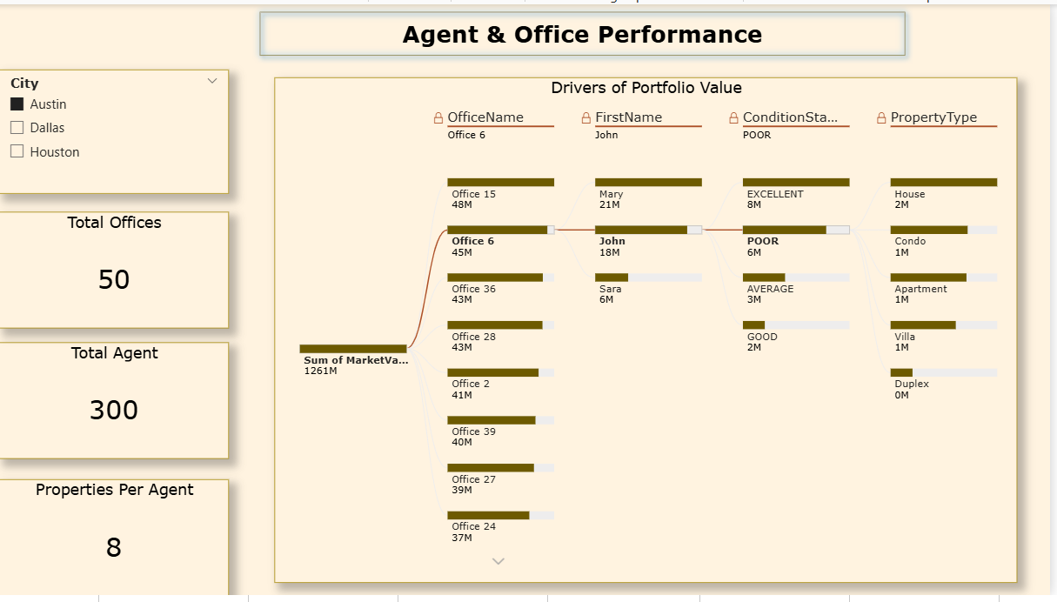

Slide 8
Neighbourhood Performance & Impact Dashboard
Business Problem
Lack of insight into neighborhood-level performance.
No understanding of how crime rate and location impact market value.
Investors could not identify high-potential areas.
Solutions
Created Neighborhood Performance Dashboard:
Average Market Value
Property Count
Average Property Size
Added:
Market value trend over time
Scatter plot: Crime Rate vs Market Value
Enabled location-based investment decisions and risk analysis.

Slide 9
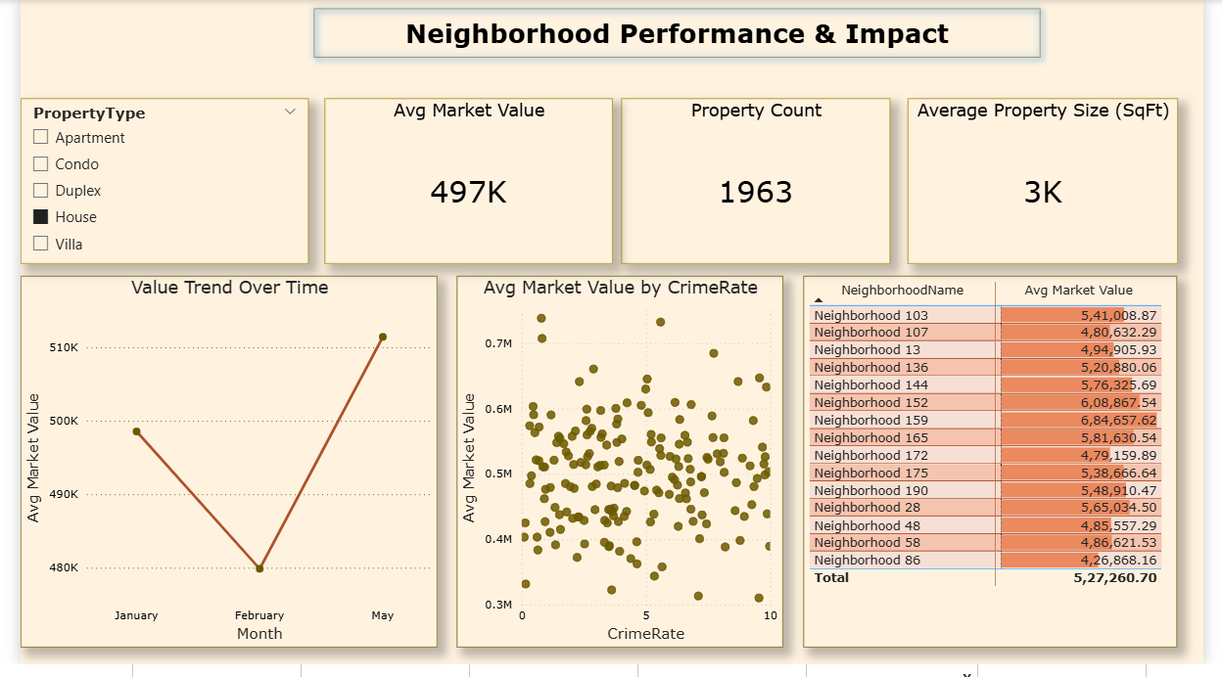

Slide 10
Property Features & Quality Analysis Dashboard
Business Problem
No structured analysis of property features like bedrooms, bathrooms, parking,
age.
Difficult to understand how furnishing and condition affect value.
Feature-based pricing was not optimized.
Solutions
Built Property Features & Quality Dashboard:
  Avg Bedrooms, Bathrooms, Parking, Property Age
  Feature comparison by Property Type
  Furnishing distribution (Furnished / Semi / Unfurnished)
Helped stakeholders understand which features increase value.
Improved feature-driven pricing and marketing strategy.

Slide 11
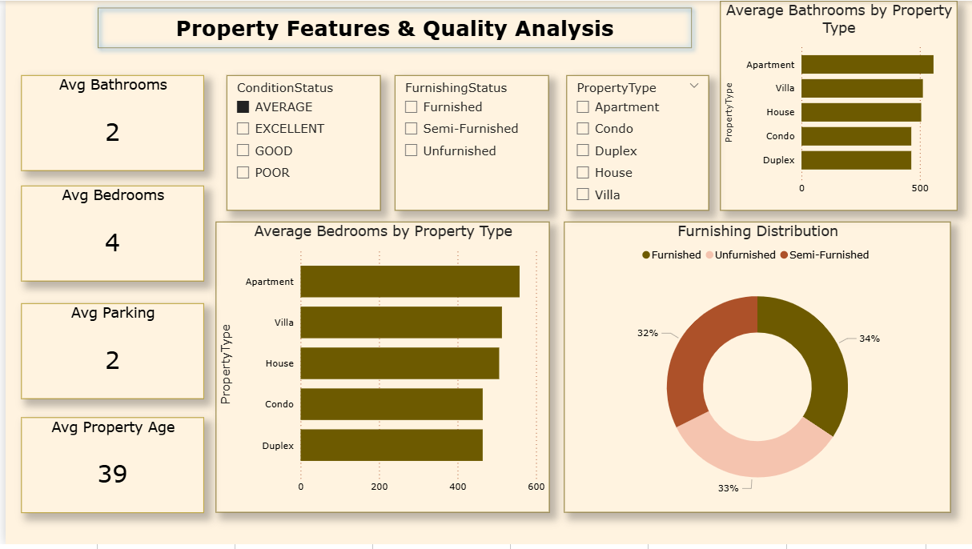

Slide 12
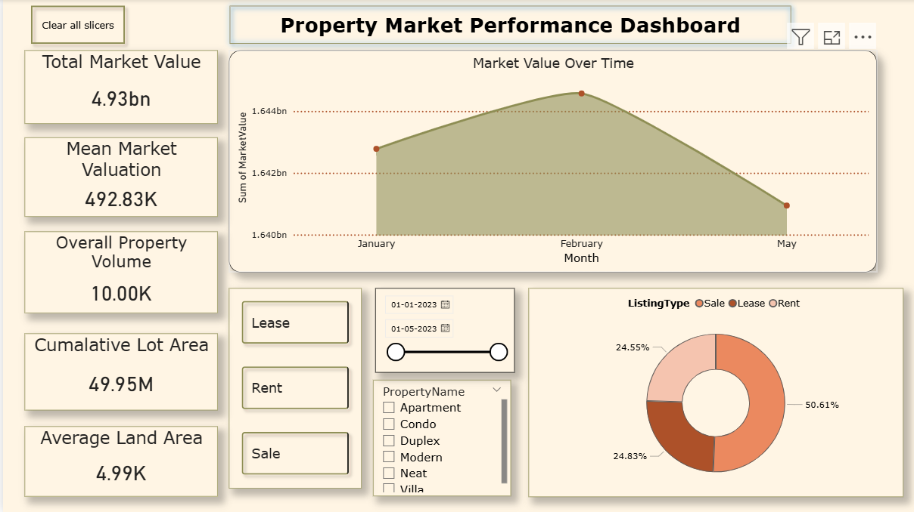

Slide 13
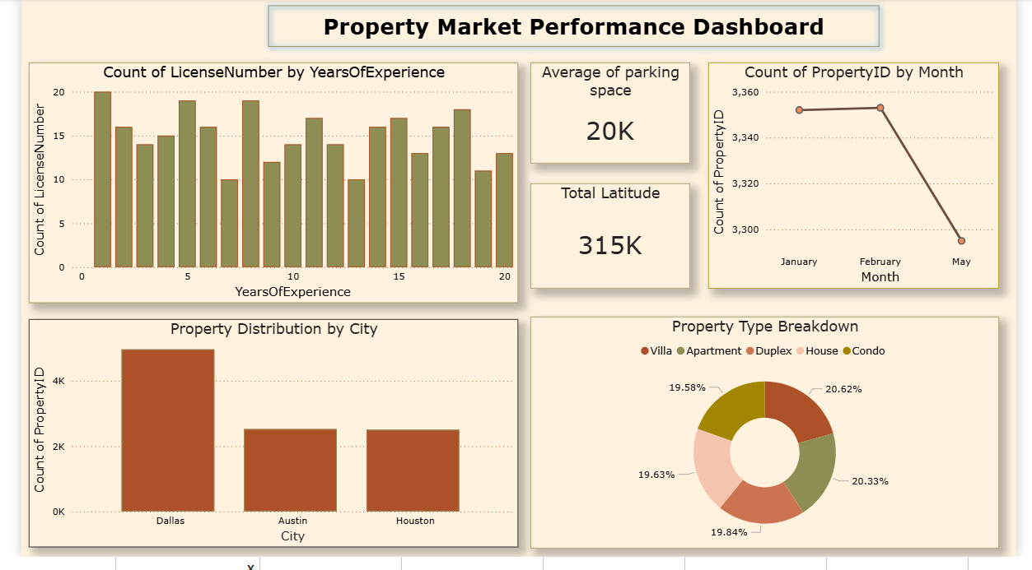

Slide 14
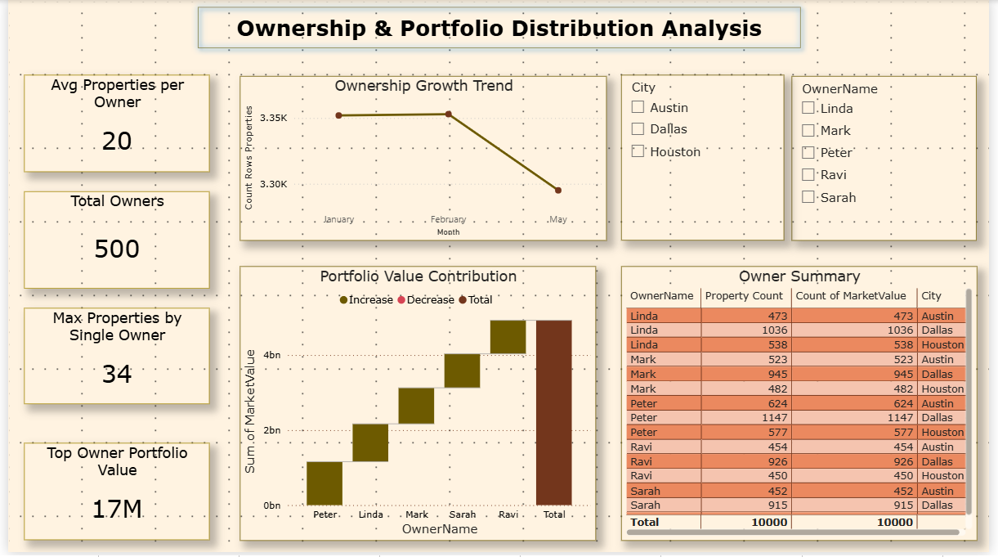

Slide 15
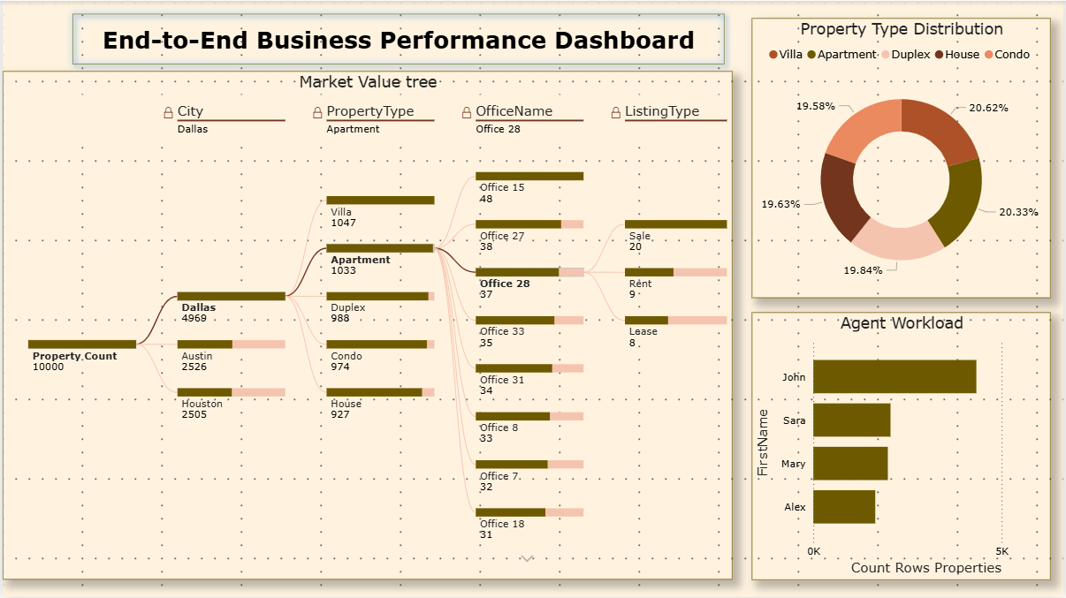

Slide 16
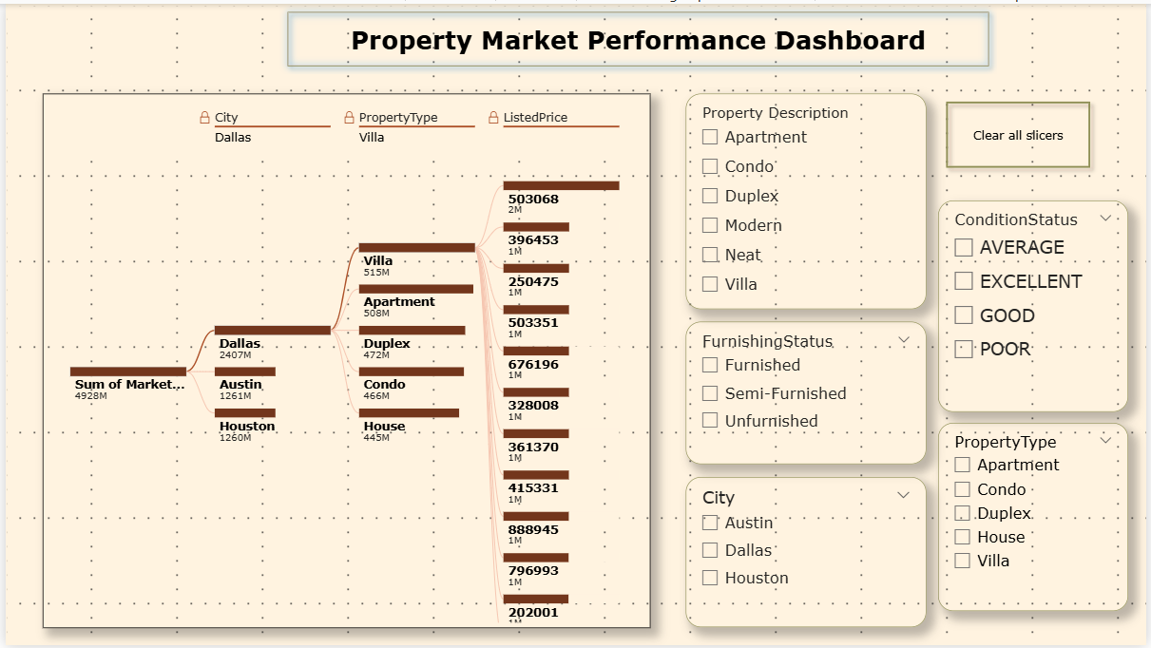

Slide 17
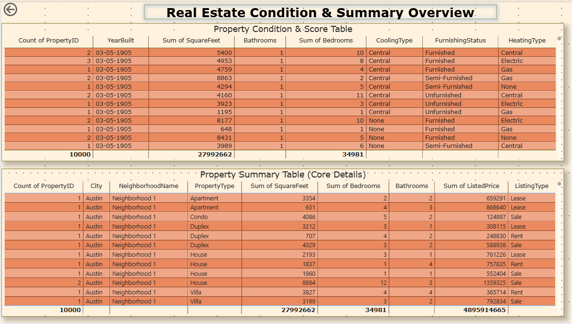

Slide 18
Thank You

